Slide 1
Gate Level Minimization
Chapter 3
Imran Siddiqi
imran.siddiqi@mcs.edu.pk
Computer Science Department
College of Telecommunication Engineering
National University of Sciences and Technology

Slide 2
Five Variable Kmap
A=0
A=1
DE
D
DE
D
BC
00
01
11
10
BC
00
01
11
10
00
m₀ | m₁ | m₃ | m₂
m₄ | m₅ | m₇ | m₆
m₁₂ | m₁₃ | m₁₅ | m₁₄
m₈ | m₉ | m₁₁ | m₁₀
00
m₁₆ | m₁₇ | m₁₉ | m₁₈
m₂₀ | m₂₁ | m₂₃ | m₂₂
m₂₈ | m₂₉ | m₃₁ | m₃₀
m24 | m₂₅ | m₂₇ | M₂₆
01
01
C
11
11
C
B
B
10
10
E
E
Five Variable K Maps have 32 squares

Slide 3
SOP and POS Simplification
The minimized Boolean function derived from a k-map is expressed in the sum of products form.
The squares marked with 1’s in the map represent the minterms of the function.
The unmarked squares represent the complement of the function.

Slide 4
SOP and POS Simplification
From the unmarked squares, we can obtain the simplified complement of the function
Applying DeMorgan’s theorem on the simplified complement of the function, we obtain the simplified function in product of sums

Slide 5
Example 1
Simplify the function
f(A,B,C,D)=Σ(0,1,2,5,8,9,10) in
Sum of products and product of sums
 | 00 | 01 | 11 | 10
00 | 1 | 1 |  | 1
01 |  | 1
11
10 | 1 | 1 |  | 1
The simplified expression in
sum of products is given by
f(A,B,C,D)=B’D’+B’C’+A’C’D

Slide 6
Example 1
The complement of the function is mapped as those marked with 0’s as shown below:
 | 00 | 01 | 11 | 10
00 | 1 | 1 | 0 | 1
01 | 0 | 1 | 0 | 0
11 | 0 | 0 | 0 | 0
10 | 1 | 1 | 0 | 1

Slide 7
Example 1
The simplified expression for the complement of the function is
f‘(A,B,C,D)=AB+CD+BD’
 | 00 | 01 | 11 | 10
00 |  |  | 0
01 | 0 |  | 0 | 0
11 | 0 | 0 | 0 | 0
10 |  |  | 0
Applying DeMorgan’s theorem, we obtain the simplified function in product of sums:
f(A,B,C,D)=(A’+B’)(C’+D’)(B’+D)

Slide 8
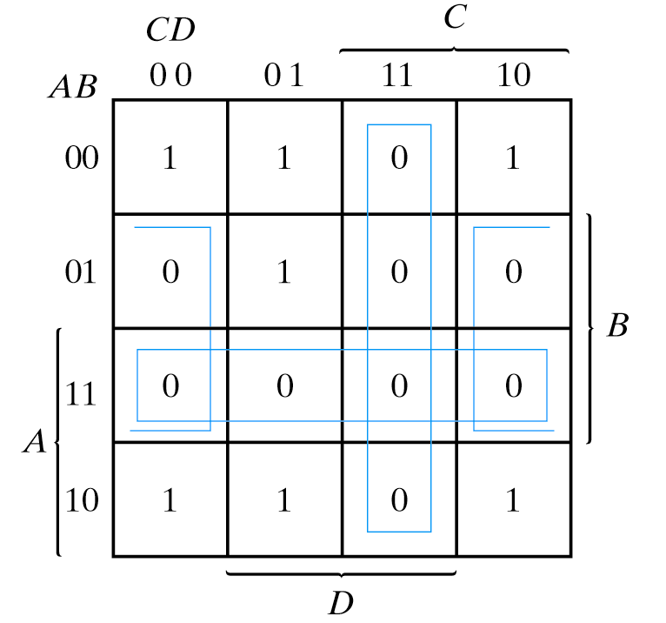


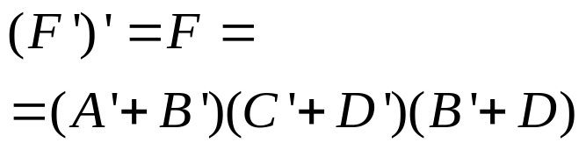
Example 2
Simplify the following in:
sum of products
product of sums
Combining the one’s:
(a)
Combining the zero’s:
Taking the the complement:
(b)

Slide 9
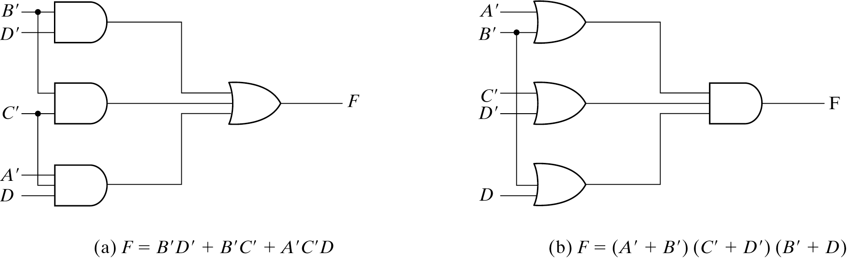
SOP & POS Implementation
SUM OF PRODUCT (SOP)
PRODUCT OF SUM (POS)

Slide 10
Kmap Summary
K-maps are an alternative to algebra for simplifying expressions
  The result is a SoP/PoS, which leads to a minimal two-level circuit
  K-maps are really only good for manual simplification of small expressions...
Things to keep in mind:
  Remember the correct order of minterms/maxterms on the K-map
  When grouping, you can wrap around all sides of the K-map, and your groups can overlap
  Make as few rectangles as possible, but make each of them as large as possible. This leads to fewer, but simpler, product terms
  There may be more than one valid solution

Slide 11

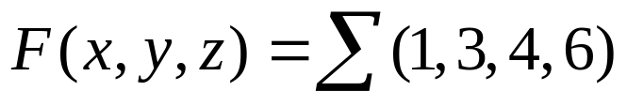
How to Fill the Map
CASE 1
Function is given as a sum of minterms
Mark the squares listed in the function with 1
Mark all the remaining squares with 0

Slide 12
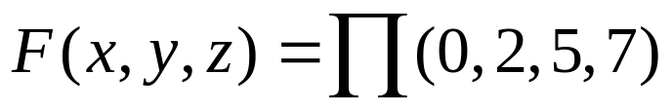
How to Fill the Map
CASE 2
Function is given as a product of maxterms
Mark all the squares listed in the function with 0
Mark the remaining squares with 1

Slide 13

How to Fill the Map
CASE 3
Function is given as a sum of products
Represent F as a sum of minterms (Fill missing literals)
Mark all the squares listed in F with 1
Mark the remaining squares with 0

Slide 14


How to Fill the Map
CASE 4
Function is given as a product of sums
First take complement of the function
Represent F’ as sum of minterms (Fill the missing literals)
Mark all the squares listed in F’ with 0
Mark the remaining squares with 1

Slide 15
Getting the Desired Simplified Form
Function can be given in any of the four forms discussed on the last 4 slides
For each of these cases if
  The simplified answer is required is Sum of Products form
    Group the 1s together
  The simplified answer is required in Product of Sums form
    Group 0s together
    Take the complement

Slide 16
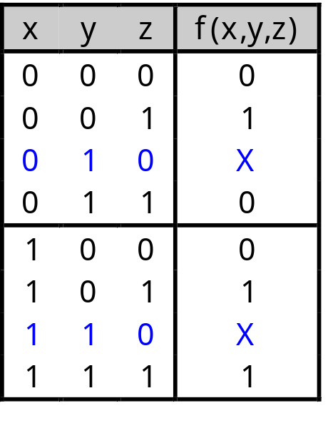
Don’t Care States
You don’t always need all 2^{n} input combinations in an n-variable function
  If you can guarantee that certain input combinations never occur
  If some outputs aren’t used in the rest of the circuit
We mark don’t-care outputs in truth tables and K-maps with Xs.
Within a K-map, each X can be considered as either 0 or 1. You should pick the interpretation that allows for the most simplification.

Slide 17
Don’t Care States
Y
1
1
1
1
X
1
1
W
1
x
Z
f(w,x,y,z)= x’z’ + w’xy’ + wxy

Slide 18
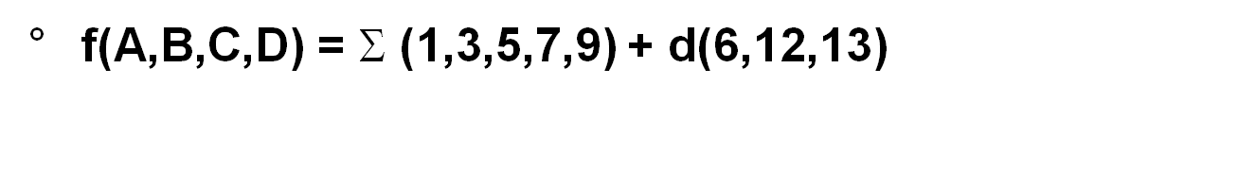
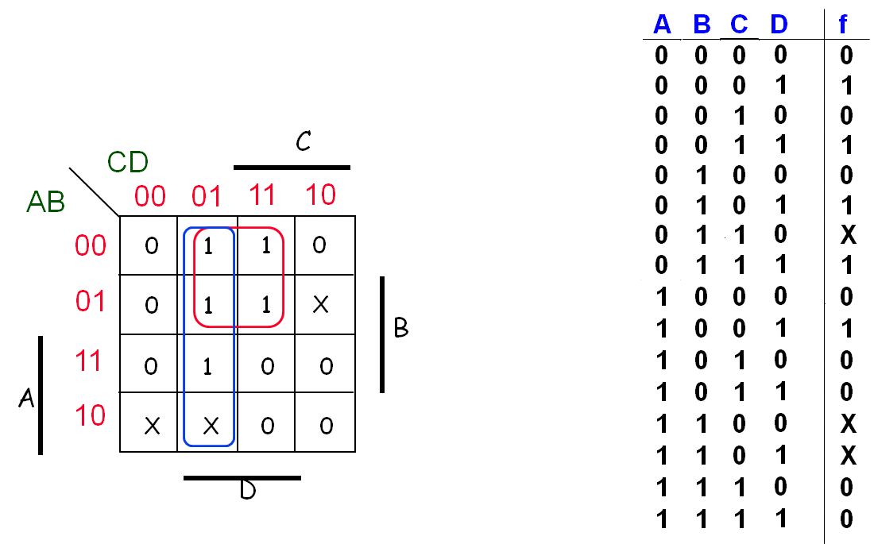
Don’t Care States

Slide 19
Don’t Care States
f = A'D + BC'D without don't cares
f = A’D + C’D with don't cares

Slide 20
The Universal Gates
NAND
NOR
Universal gate because they can be used to implement any logic gate

Slide 21
NAND Gate
AND-Invert
F = (xyz)’
Invert-OR
F = x’+y’+z’

Slide 22
NOR Gate
OR-Invert
F = (x+y+z)’
Invert-AND
F = x’y’z’

Slide 23

NOT Gate
AND-Invert
OR-Invert
Buffer-Invert

Slide 24
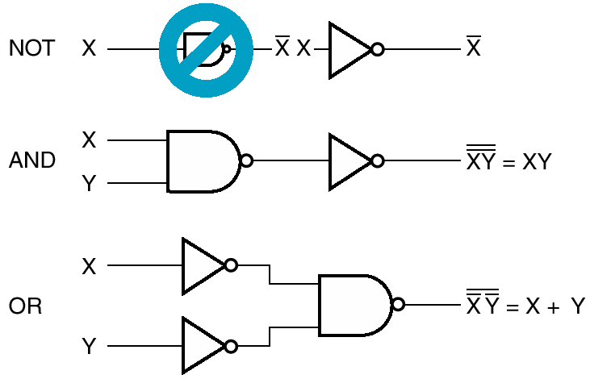
NAND Implementation

Slide 25
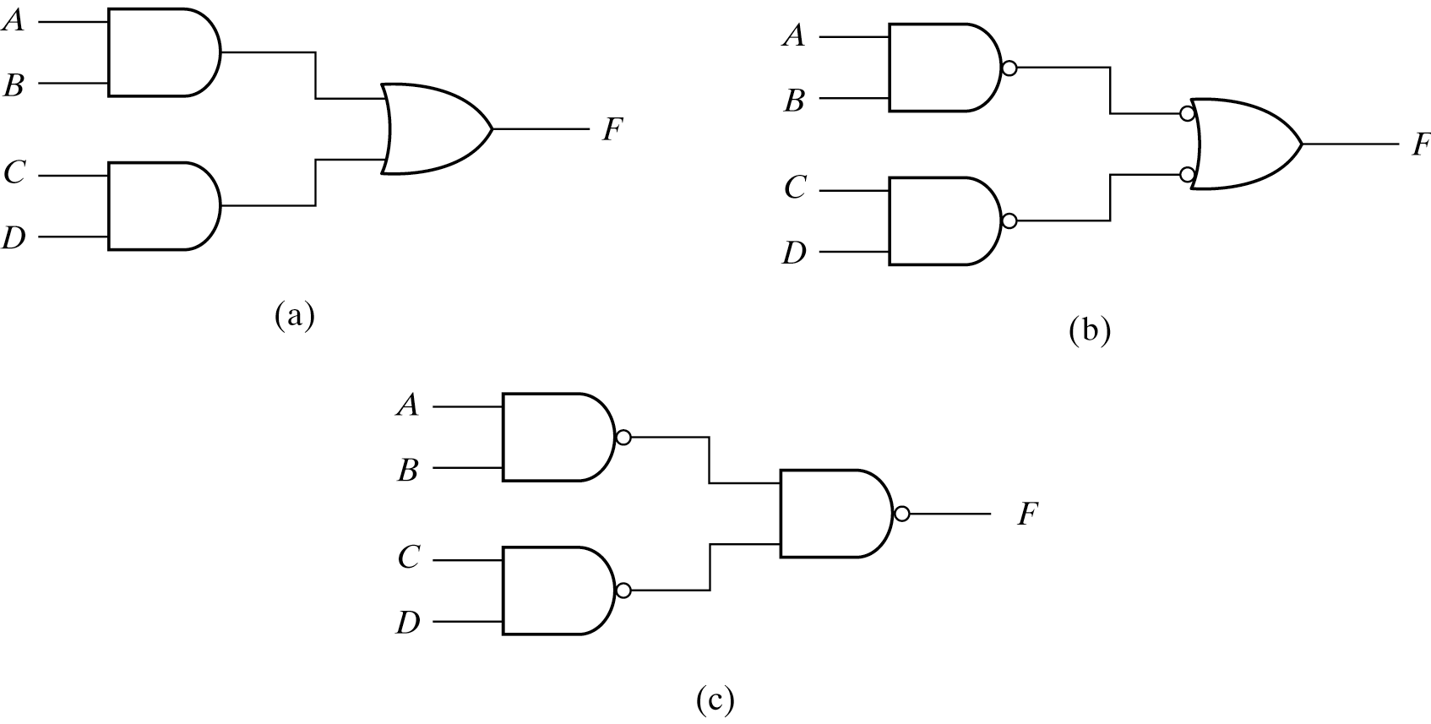
Two-Level NAND Implementation
Example: F = AB+CD
Three ways to implement F=AB+CD

Slide 26


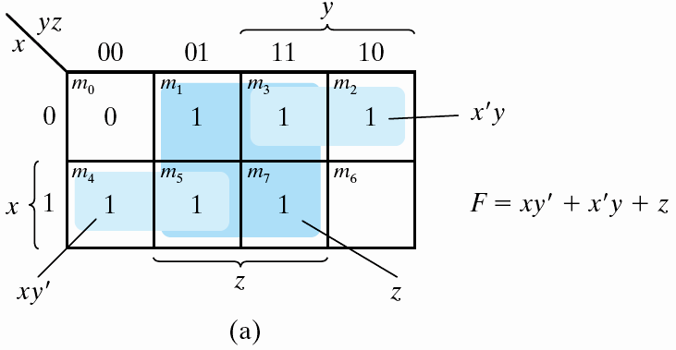
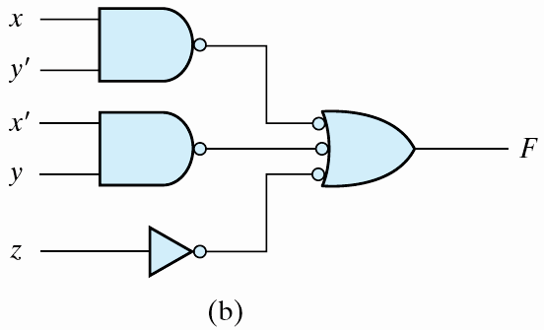
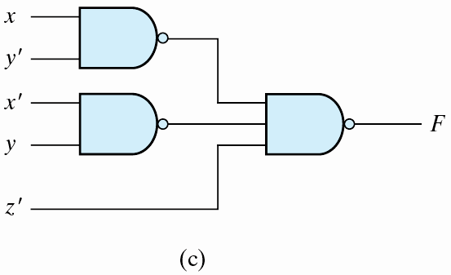
Two-Level NAND Implementation

Slide 27
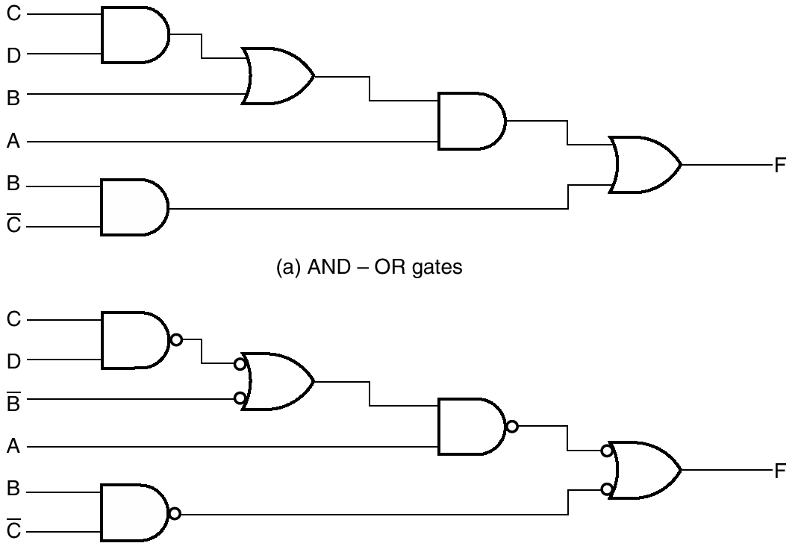
Multilevel NAND Circuits
Implementing F = A(CD + B) + BC′
Bubbles cancel each other
Note this complement

Slide 28
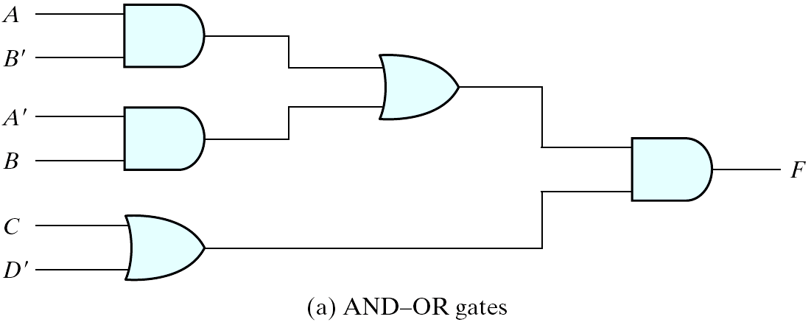
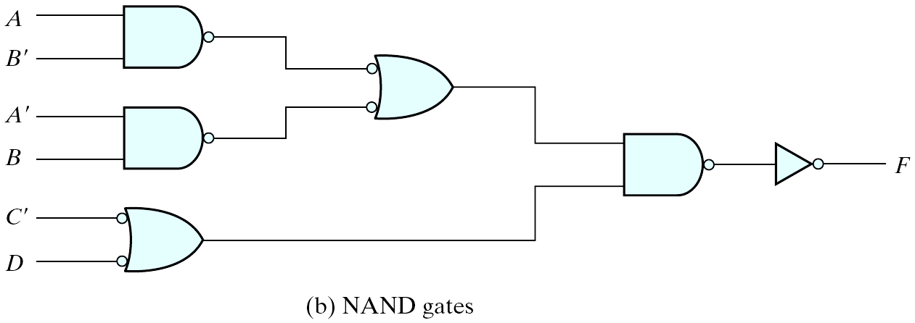
Multilevel NAND Circuits
Implementing F = (AB′ +A′B)(C+ D′)

Slide 29
NAND Circuits – General Procedure
Convert all AND gates to NAND gates with AND-NOT graphic symbols
Convert all OR gates to NAND gates with NOT-OR graphic symbols
Check all the bubbles in the diagram
  Every bubble that is not compensated by another along the same line will require the insertion of an inverter or complement the input literal

Slide 30
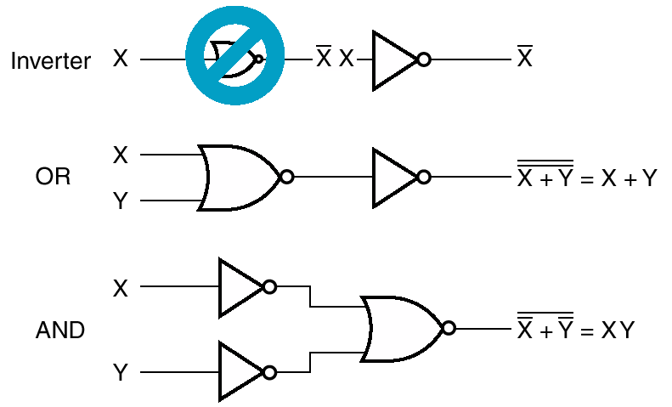
NOR Implementation

Slide 31
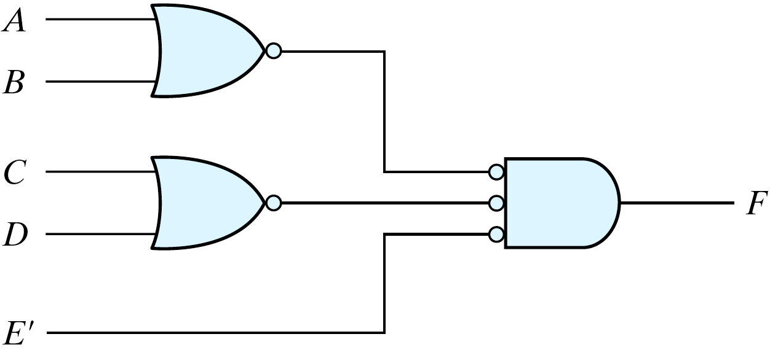
Two-Level NOR Implementation
Implementing F = (A + B)(C + D)E

Slide 32
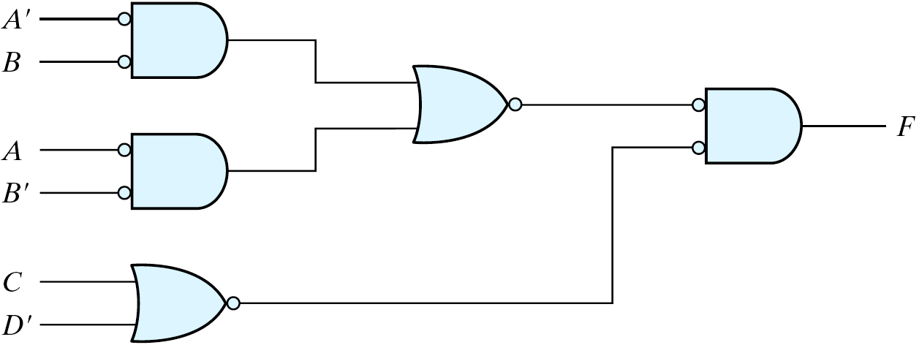
Multilevel NOR Circuit
Implementing F = (AB′ +A′B)(C + D′)

Slide 33
NAND/NOR Summary
Given a function, if you are asked to implement it with
  NAND Gates ONLY
    Simplify the function to Sum of Products form
    Implement it using two level AND-OR circuit
    Convert the AND-OR to NAND-NAND circuit
  NOR Gates ONLY
    Simplify the function to Product of Sums
    Implement it using two level OR-AND circuit
    Covert OR-AND to NOR-NOR circuit

Slide 34
References
Chapter 3 – Digital Design Morris Mano
Material in these slides has been taken from, the following resources

